Slide 1

Lesson 2
Github

Slide 2
Let’s recap what we did in previous class
We learnt about version control system
We then talked about Git
What is Git
What are the benefits of Git
What is Git repository
We learnt few git commands to work with git in your systems
git config
git status
git add
git commit
git log
git checkout
I also asked you to figure out how to use git revert and git reset

Slide 3
Let’s see what we are going to learn today
Branching
Benefits of Github
Learn More
Step 1
Step 3
Step 4
15 mins
Step 1
Step 2
Step 3
Step 4
Step 5
What is Github
Deploying your application on github Pages

Slide 4
Branching

Slide 5
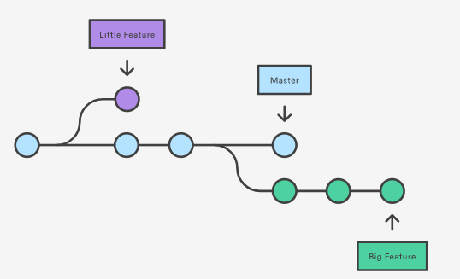
Branching
Branches are used to develop features isolated from each other.
The master branch is the "default" branch when you create a repository. Use other branches for development and merge them back to the master branch upon completion.

Slide 6

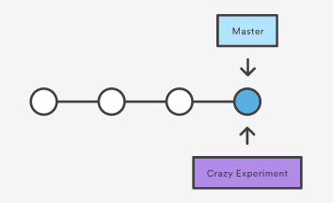
Creating Branches
It's important to understand that branches are just pointers to commits.
When we create a branch, all Git needs to do is create a new pointer, it doesn’t change the repository in any other way. If we start with a repository that looks like this:
3. Then, you create a branch using the following command:
git branch crazy-experiment
4. The repository history remains unchanged.
All you get is a new pointer to the current commit:

Slide 7
Understand branching a little deeper
Open Command prompt and type in git branch. We’ll notice that it says master branch(default branch).
Now let’s create another branch of our current project using the command git branch <branch-name>
Now type in git checkout <branch-name> to go to the newly created branch.
Let’s do some changes in the new branch and commit the changes. Don’t forget to add the changes first.
Now let’s say we want to merge the newly created branch into the master branch.
We will go to the master branch git checkout master
Then we merge newly created branch into master branch using git merge <branch-name>.

Slide 8
What is Github

Slide 9
What is Github?
Github is not the same as git. GitHub is a repository hosting service. Think of it as the "cloud" for code.
But I can use google drive or dropbox as well? Yes but github is designed specially for this purpose.
Github is a website/platform while git is a tool.
GitHub will host our source code projects written in a variety of different programming languages and keep track of the various changes made to every iteration.
It is able to do this by using git, a revision control system that runs in the command line interface.
Github is not the only one. Other websites such as such as BitBucket, GitLab or Gitorious use git

Slide 10
Why Github?

Slide 11
Why Github ?
Github is like a social networking site for programmers.
We can safely store our codes on the cloud.
To share our code with others, we do not need to email the recipients the compressed zip files or anything. Sharing codes via compressed zip files and emailing the code is history.
Companies love it when you have a github profile and they can see your work before even calling you for an interview.

Slide 12
What to do now ?
First create an account on github
Make sure your username is professional. coolsmartboy1994 or dhinchakpooja does not work.

Slide 13
Remote Repository

Slide 14
Remote Repository
Like you created a repo or repository on your laptop you will need to create a repo on github as well.
Github repo is often referred to as remote repo. Remote? Because it is not close to you, it is remote, it is on the cloud.
Every project needs one remote repo for itself. Let's create one right now.

Slide 15
Before you can put your code on github remote
you need to tell your local repo the url for the remote repo.

Slide 16
Connecting to remote repository
Once you have a remote repo setup, you will need to add a remote repo url to your local git config, and set an upstream branch for your local branches. The git remote command offers such utility.
This command will map remote repository at <remote_repo_url> to a ref in your local repo under <remote_name>. Once you have mapped the remote repo you can push local branches to it.
git remote add origin <remote-repo-url>
Remote connections are more like bookmarks rather than direct links into other repositories.

Slide 17
Syncing your code to remote repo
git remote | git fetch | git pull | git push

Slide 18
Syncing : git push
Pushing is how you transfer commits from your local repository to a remote repo.
git push <remote> <branch>
If we want to push the commits in the master branch to the remote repo at origin : git push origin master

Slide 19
How often should I push my code to github?
As often as possible. It is your CTRL+S in the cloud. Your laptop is unreliable. You should push every few hours or whenever you have had some significant progress in your work. This means multiple commits.

Slide 20
How to submit project on Acadview?
Make a project folder on your laptop and a remote repo on github.
Make your project folder a git repo and set the url for the remote repo.
Keep pushing the code on a daily basis to the remote repo. Support staff will be monitoring your progress on a daily basis.
Make sure all the code has been pushed to github and objectives have been met.

Slide 21
Syncing : git pull
Merging upstream changes into your local repository is a common task in Git-based collaboration workflows.
This can also be done with git fetch followed by git merge, but git pull rolls this into a single command.
git pull <remote>

Slide 22
Quick recap
Create a repository on Github
Configure your local repo to add the github repo url git remote add origin <remote-url-repo>
Push/upload the code from the laptop to github repo git push origin <existing-branch-name>
Pull the code from remote repository to local computer git pull <remote>

Slide 23
Cloning an existing repository: git clone
git clone is primarily used to point to an existing repo and make a clone or copy of that repo at in a new directory, at another location.
The original repository can be located on the local filesystem or on remote machine accessible supported protocols.
The git clone command copies an existing Git repository.
Cloning to a specific folder git clone <repo> <directory>

Slide 24
Syncing : git fetch
Fetching is what you do when you want to see what everybody else has been working on. Since fetched content is represented as a remote branch, it has absolutely no effect on your local development work. This makes fetching a safe way to review commits before integrating them with your local repository.
The git fetch command imports commits from a remote repository into your local repo. The resulting commits are stored as remote branches instead of the normal local branches that we’ve been working with.
This gives you a chance to review changes before integrating them into your copy of the project. git fetch <remote> <branch>

Slide 25
That’s all for today.
Congratulations Guys!
we’ve successfully completed Git and Github

Slide 26
Homework

